Slide 1
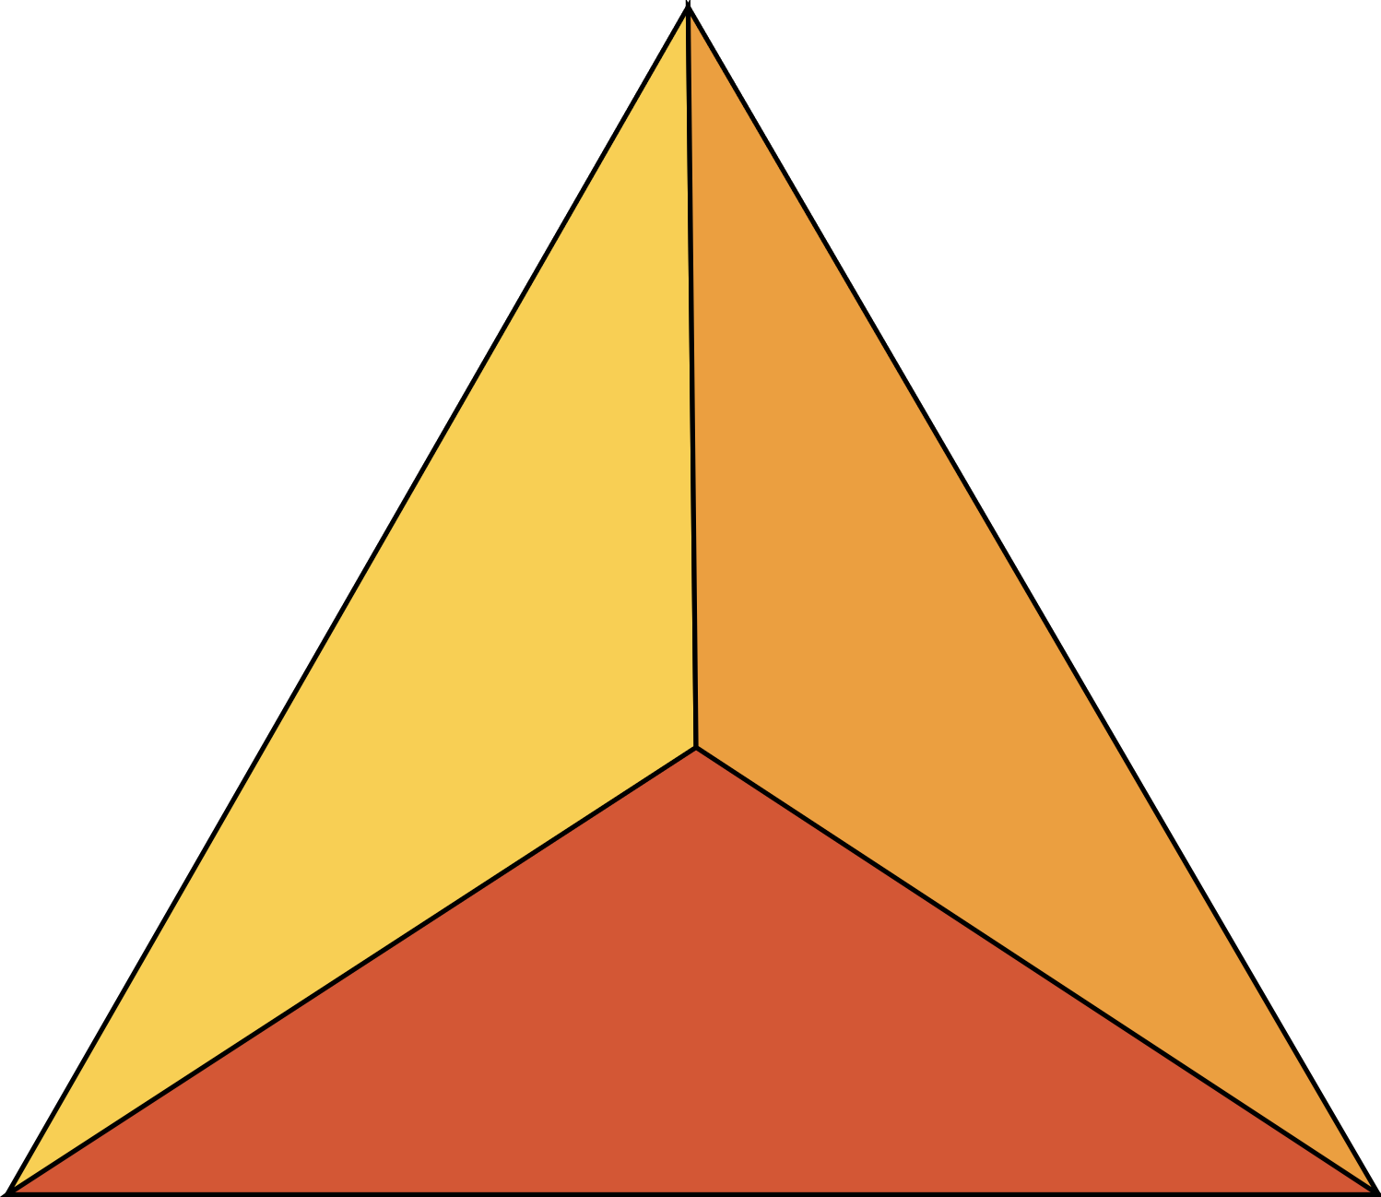
Lesson 5:
Firefighters

Slide 2
Pre-lesson Questions
What is the job of a firefighter?
Who are firefighters?
What can firefighters do?
When should you call for help when a fire starts?

Slide 3
Lesson 5: Firefighters
2 types of firefighters
Volunteer
Paid

Slide 4
Different firefighting disciplines
Structure
Wildland
Crash/Rescue
Industrial
Example images for each point

Slide 5
Fire fighters work for
Local fire districts
Example images for each point

Slide 6
Fire fighters work for
Cities
Example images for each point

Slide 7
Fire fighters work for
State agencies
Example images for each point

Slide 8
Fire fighters work for
Tribal governments
Example images for each point

Slide 9
Fire fighters work for
Federal agencies
Example images for each point

Slide 10
Fire fighters work for
Non-profits
Example images for each point

Slide 11
Fire fighters work for
Private/Contracted
Example images for each point

Slide 12
What determines the capabilities of firefighters?
Training
Experience
Resources
Example images for each point

Slide 13
Limitations of firefighters
Science
Number of firefighters
Resources
Example images for each point

Slide 14
Firefighters who support your area
Fill in with local information
Fill in with local information
Fill in with local information
Fill in with local information

Slide 15
The best time to meet firefighters
Example images for each point

Slide 16
Planning with firefighters
Lists of risk
Water sources
List of resources
To do list
Example images for each point

