Slide 1
Lesson 4:
Wildfire & Your Yard

Slide 2
Pre-lesson Questions
How far can a fire ember travel and start another fire?
Where and why do fires start on the farm/ranch?
What does it take to keep the items of value in your yard from catching or spreading fire?
How fast do fires spread?

Slide 3
Where & why do fires starts in the farm/ranch yard?

Slide 4
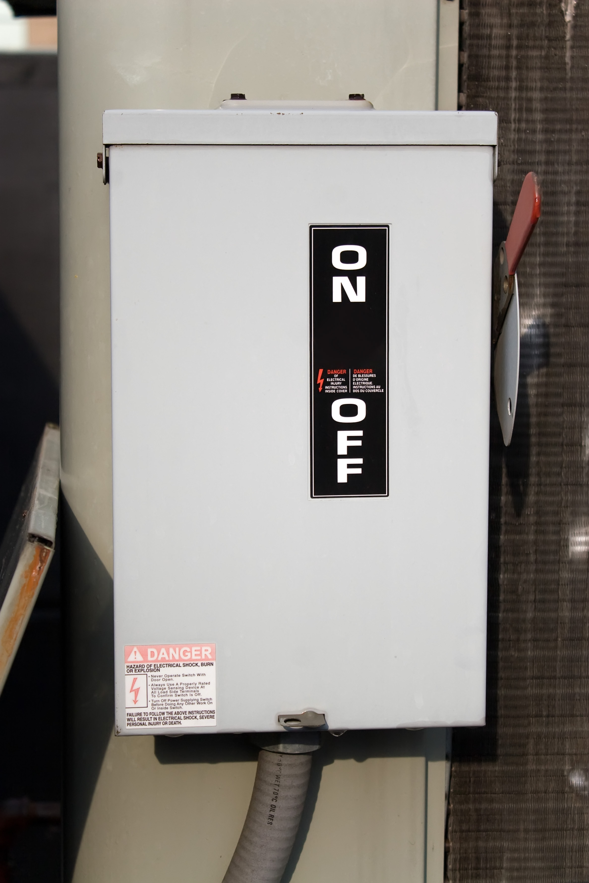
Electrical

Slide 5
Conduction
Replace

Slide 6
Chemical
Replace
Replace

Slide 7
Combustion

Slide 8
Friction

Slide 9
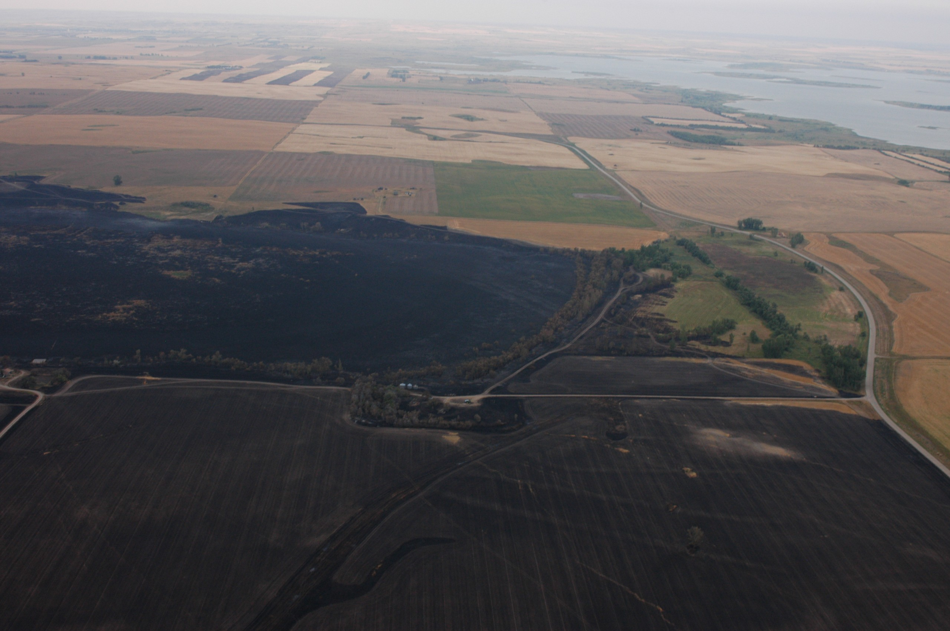
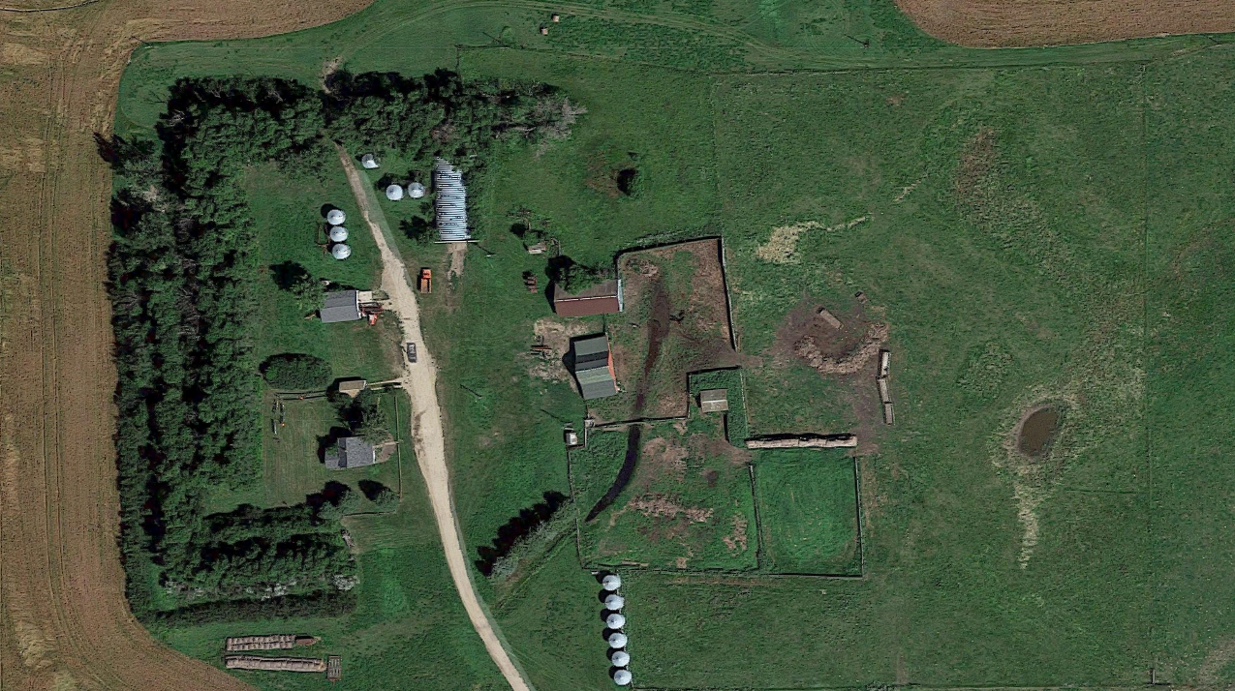
Fuel continuity

Slide 10
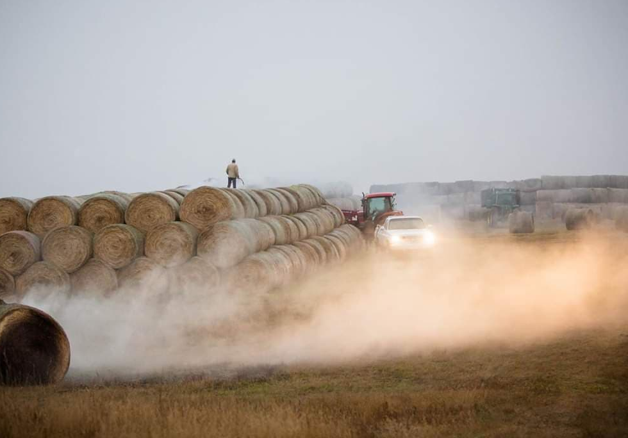
Identify examples of continuity in your yard

Slide 11
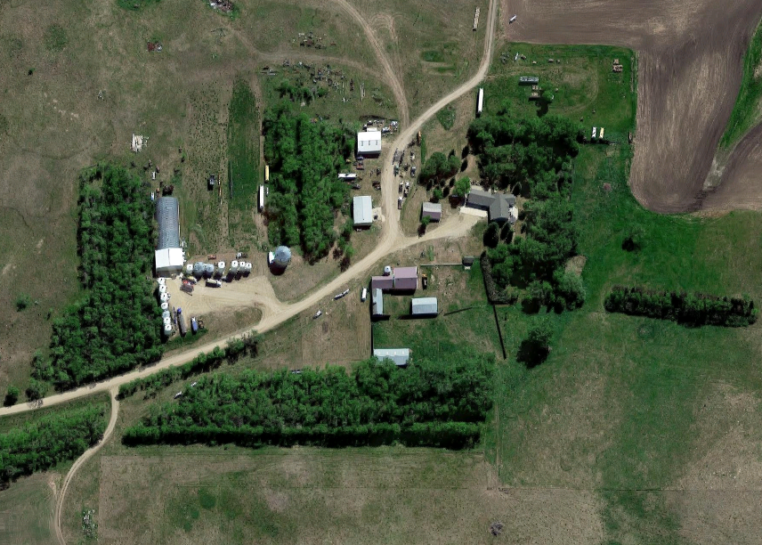
Two things your yard is made of
Fuel

Slide 12
Two things your yard is made of
Fuel
Fuel Breaks

Slide 13
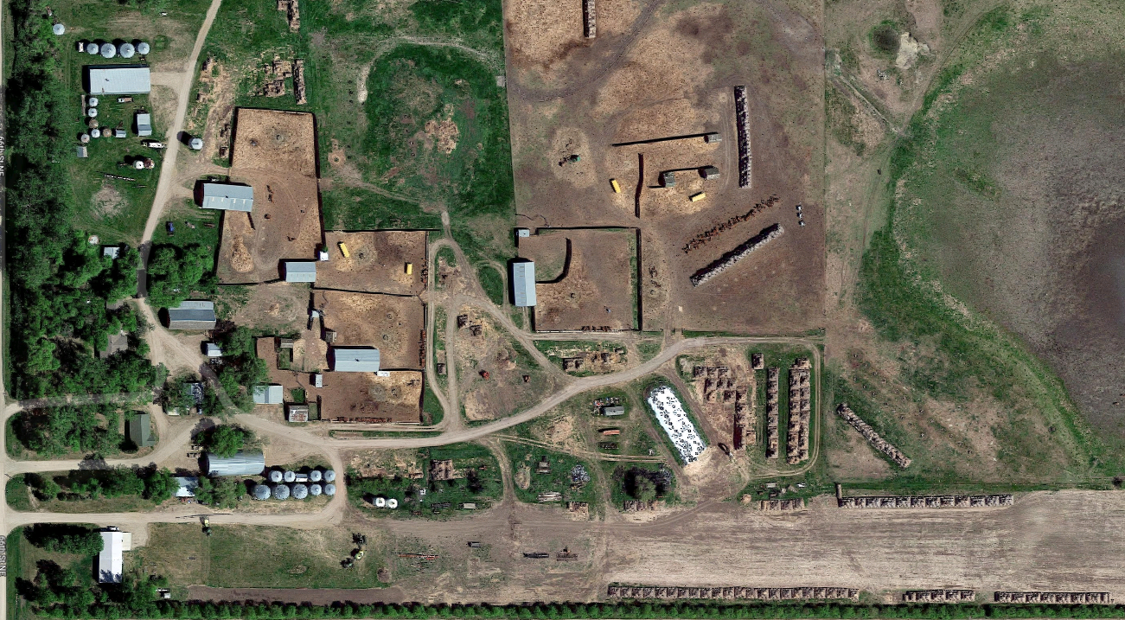
Identify the fuel in this picture

Slide 14
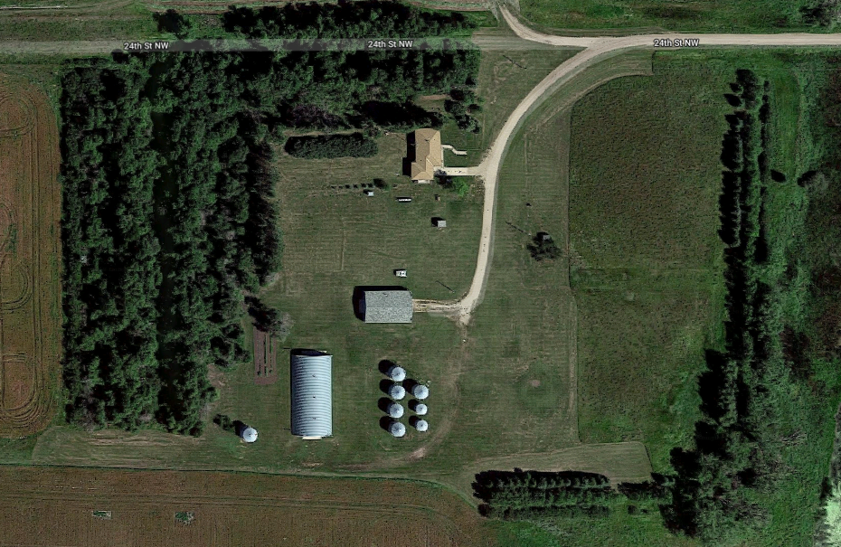
Identify the fuel breaks in this picture

Slide 15
Determining the size of a fuel break when no wind is present
Source Flame Height x 4 = Fuel Break Size
Flame
GFX
Flame
Height
Fuel Break

Slide 16
Factors that affect rate of fire spread
Continuity

Slide 17
Factors that affect rate of fire spread
Continuity
Wind Speed & Direction

Slide 18
Factors that affect rate of fire spread
Continuity
Wind Speed & Direction
Fuel Moisture

Slide 19
Factors that affect rate of fire spread
Continuity
Wind Speed & Direction
Fuel Moisture
Temperature

Slide 20
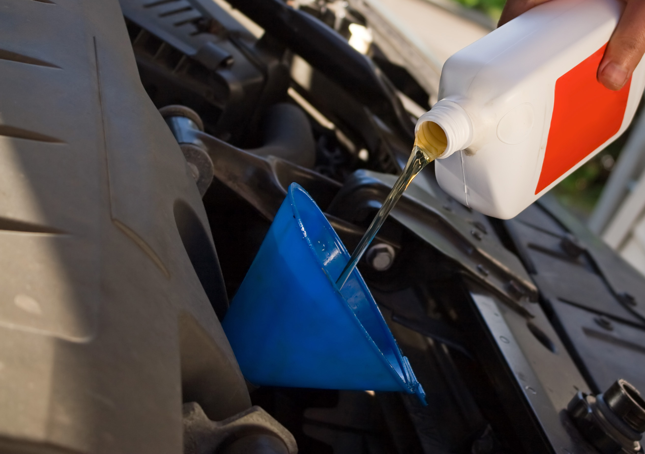
How to prevent fires in the yard
Proper maintenance

Slide 21
How to prevent fires in the yard
Proper maintenance
Clean your yard

Slide 22
How to prevent fires in the yard
Proper maintenance
Clean yard
Make repairs in a fuel break or clear zones

Slide 23
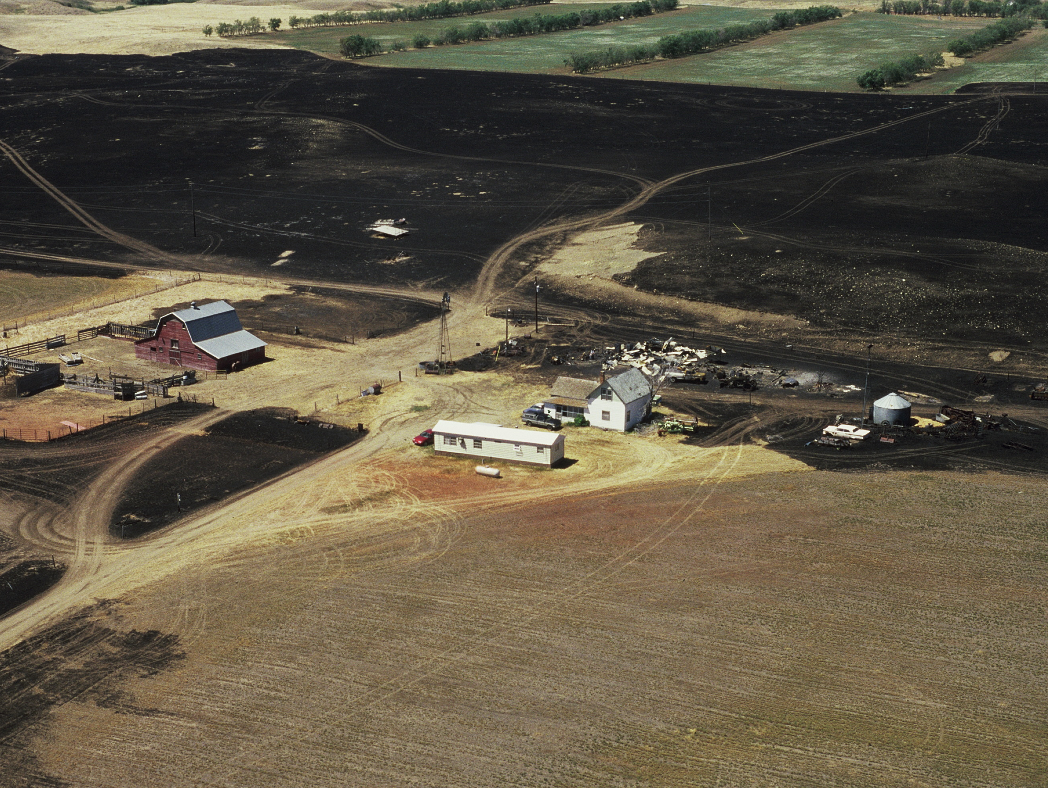
How to prevent fire spread in the yard
Maintain Fuel breaks

Slide 24
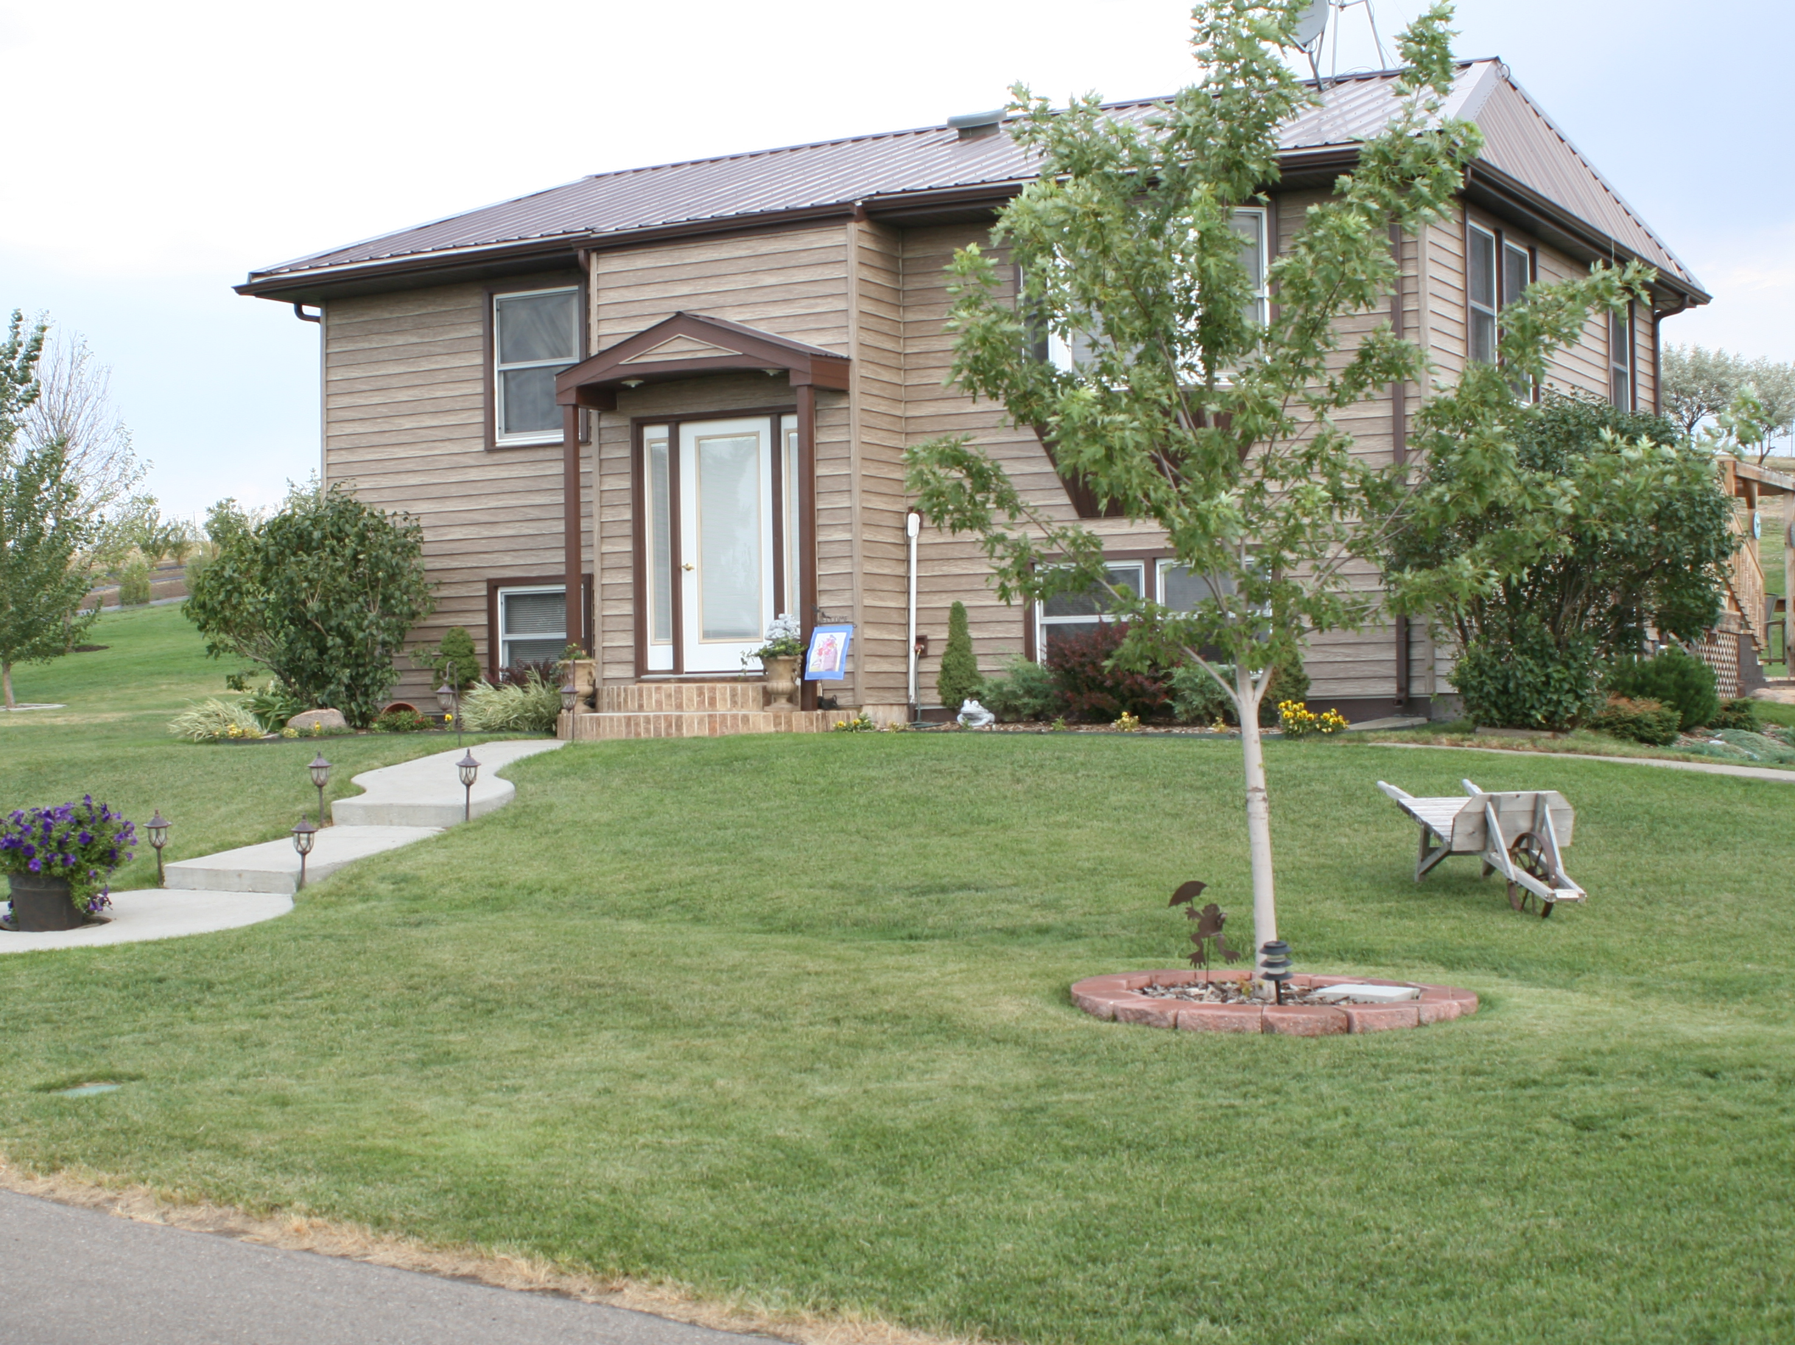
How to prevent fire spread in the yard
Maintain fuel breaks
Keep a clean yard

Slide 25
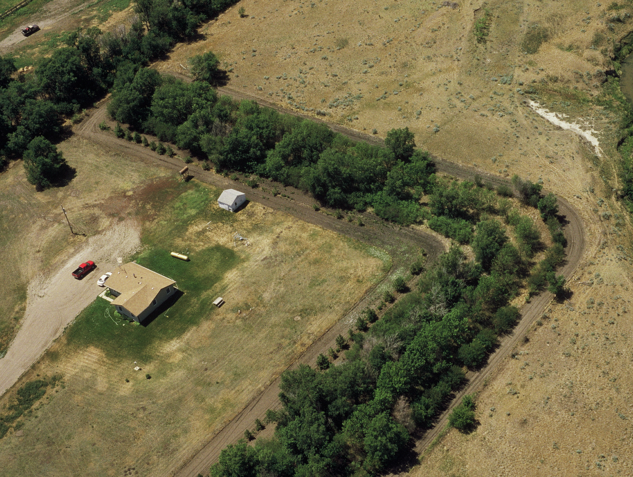
How to prevent fire spread in the yard
Maintain Fuel breaks
Clean yard
Adequate spacing of fuel

Slide 26
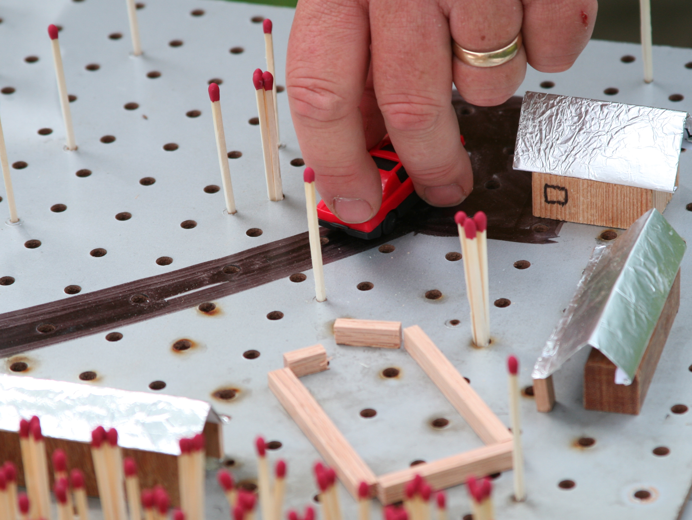
Steps you need to take to protect your yard
Calculate fuel breaks

Slide 27
Steps you need to take to protect your yard
Calculate fuel breaks
Place fuel breaks

Slide 28
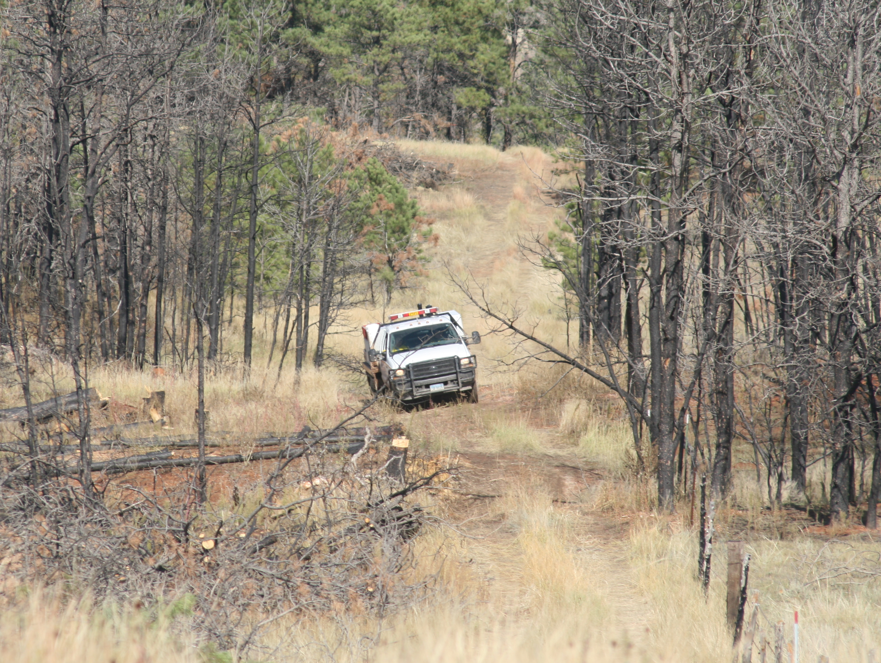
Steps you need to take to protect your yard
Calculate fuel breaks
Place fuel breaks
Maintain fuel breaks

Slide 29
Fire Plan

Slide 30
First Action
One attempt at putting out fire if you are present when it starts and practical to do so
Move to safe location
Call fire resources
Move hazards/items of value if possible and be safe

Slide 31
Who to call
911/Fire Department
Neighbors in the path of fire
Family

Slide 32
What to communicate
Location
Size
Direction of Spread
Hazards
Water Sources

